Slide 1
Query Interface design for GeoDSS
the designer must understand how people think and work
need to find a good balance/substitute/mapping for functions/algorithms -> buttons/menu items
Need to understand the database.
1. Census: e.g. Population distribution
2. Water Resource Data: e.g. Water distribution
3. Weather Data: e.g. Precipitation distribution

Slide 2
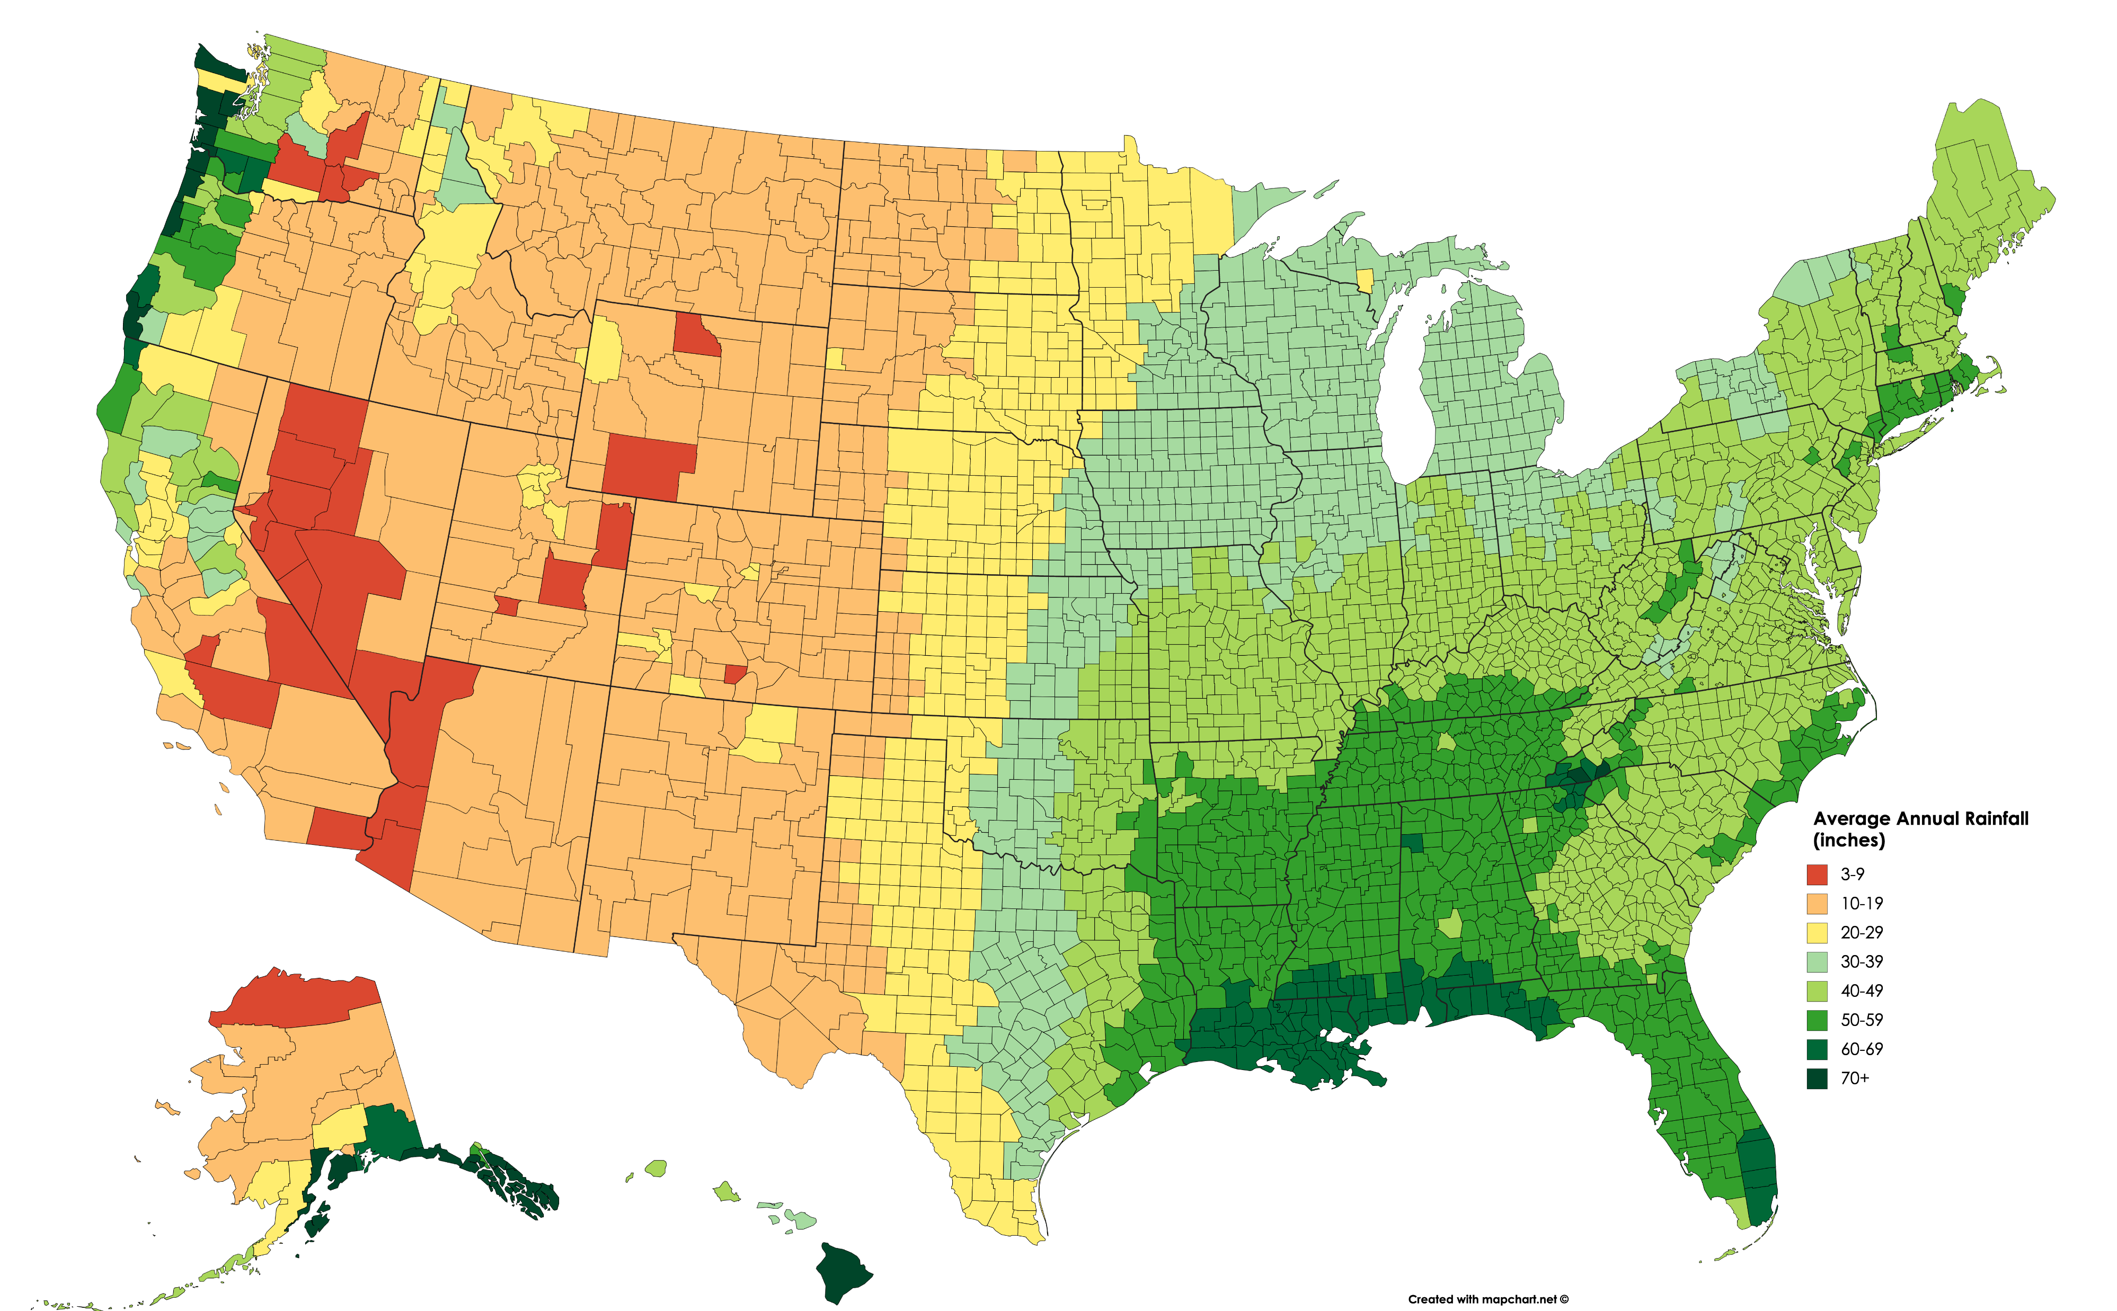
Maps and Overlays
Expectations:
- Political Boundaries(here up to county level)
- Shading/Coloring done according to range of values.(choropleth style)
Questions:
1. Base unit of division
- e.g. County, square mile,
2. Entities and their attributes:
- e.g. Dams and Water Volume
3. Overlay, or heatmaps-style Polygon shading? Depends on the info being queried.
(will have to switch between continuous and discrete acc to feature.)
Source: post on reddits’s r/dataisbeautiful

Slide 3
Area Type | GEOID Structure | Number of Digits | Example Geographic Area | Example GEOID
State | STATE | 2 | Texas | 48
County | STATE+COUNTY | 2+3=5 | Harris County, TX | 48201
County Subdivision | STATE+COUNTY+COUSUB | 2+3+5=10 | Pasadena CCD, Harris County, TX | 4820192975
Places | STATE+PLACE | 2+5=7 | Houston, TX | 4835000
Census Tract | STATE+COUNTY+TRACT | 2+3+6=11 | Census Tract 2231 in Harris County, TX | 48201223100
Block Group | STATE+COUNTY+TRACT+BLOCK GROUP | 2+3+6+1=12 | Block Group 1 in Census Tract 2231 in Harris County, TX | 482012231001
Block* | STATE+COUNTY+TRACT+BLOCK | 2+3+6+4=15 (Note – some blocks also contain a one character suffix (A, B, C, ect.) | Block 1050 in Census Tract 2231 in Harris County, TX | 482012231001050
Congressional District (113th Congress) | STATE+CD | 2+2=4 | Connecticut District 2 | 902
State Legislative District (Upper Chamber) | STATE+SLDU | 2+3=5 | Connecticut State Senate District 33 | 9033
State Legislative District (Lower Chamber) | STATE+SLDL | 2+3=5 | Connecticut State House District 147 | 9147
ZCTA ** | ZCTA | 5 | Suitland, MD ZCTA | 20746

Slide 4
System-Guided Search on a Query Interface
^{Nth} Area/Overlay
+
N-1 Overlay Transformation
1st
Area/Overlay
End Query
User
Example:
Population Overlay for Colorado
Precipitation levels overlay for Larimer County
Water Resource levels for Horse tooth Reservoir
(Population OR
Precipitation overlay changes to a height column distribution)
Plot an aggregation bin plot for large water bodies

Slide 5
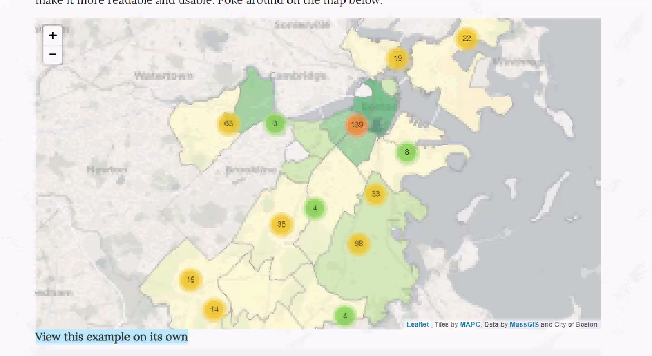
Aggregation Bin plot

Slide 6
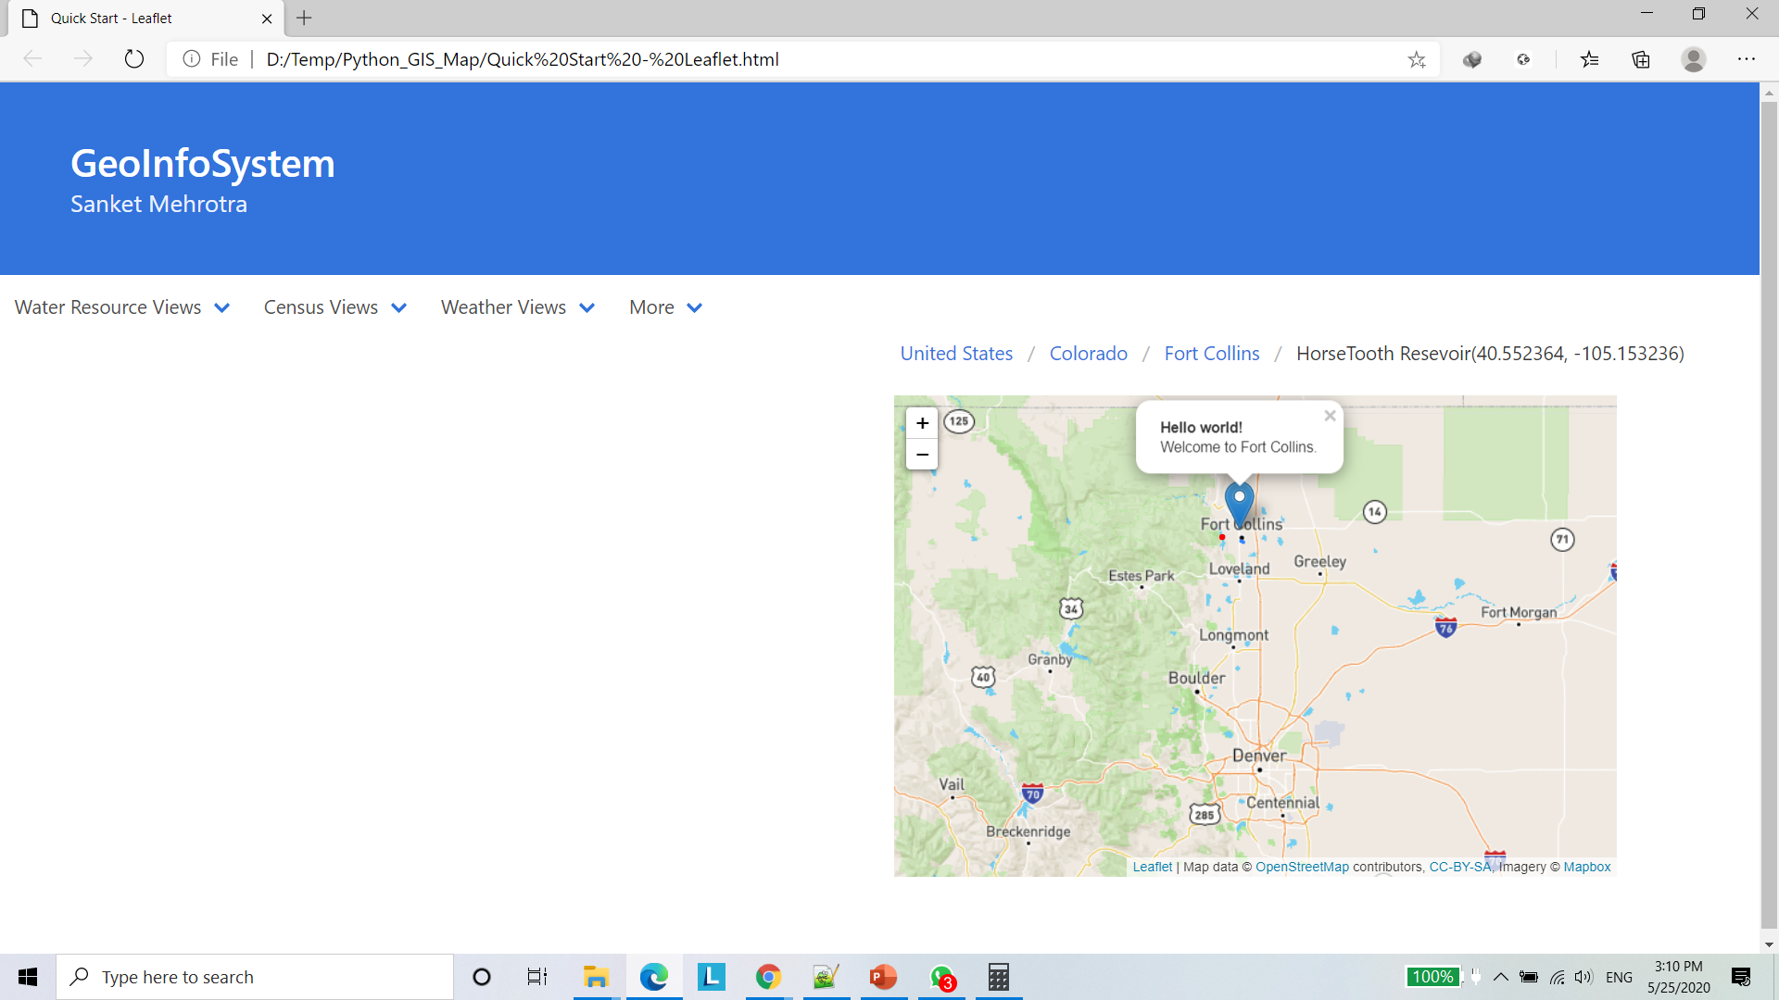
Other Ideas
Adding a breadcrumb to help the user trace their actions.
Fort Collins
Population Density: 3,023 people/sq. mile
Precipitation(in mm): 148 mm
Water Resources: 100 km³

Slide 7
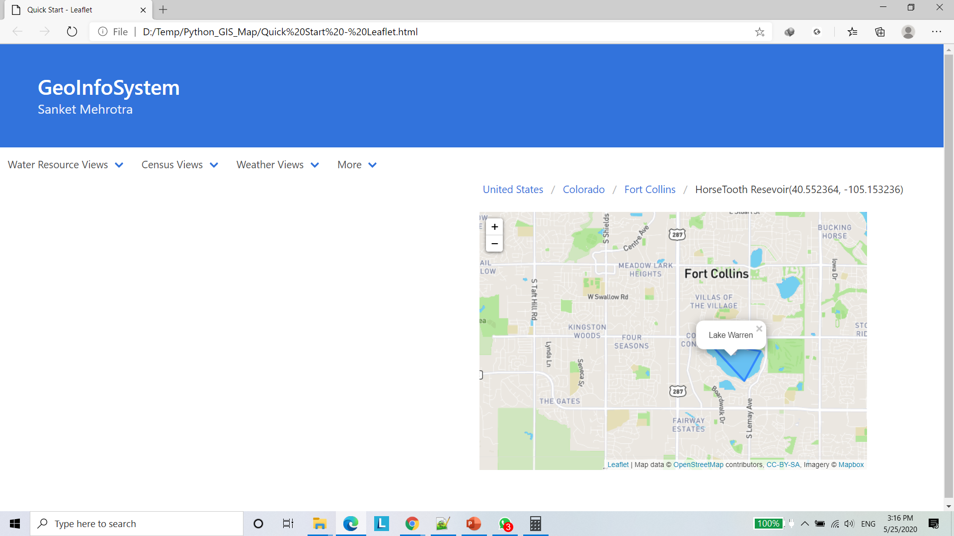
Lake Warren
Volume: 12000 km³
Source: Cache La Poudre River
Purity: 100ppm
Freshwater: Yes
Length | Breadth | Depth | Water Surface Area | Volume
563 km | 257 km | 406 m | 82,097 sq. km | 12,232 cubic km

Slide 8
Other Ideas
Having a data-flow graph on the left hand side.
to show the users the data sources they’re using
And to keep track of any transformations they could be doing.
Idea of source assessment
Like – coding Spark in Java
Water Volume:
Horsetooth Dam
Temperature: Larimer County
Projection model
View:
Projection of water level over 4 years

Slide 9
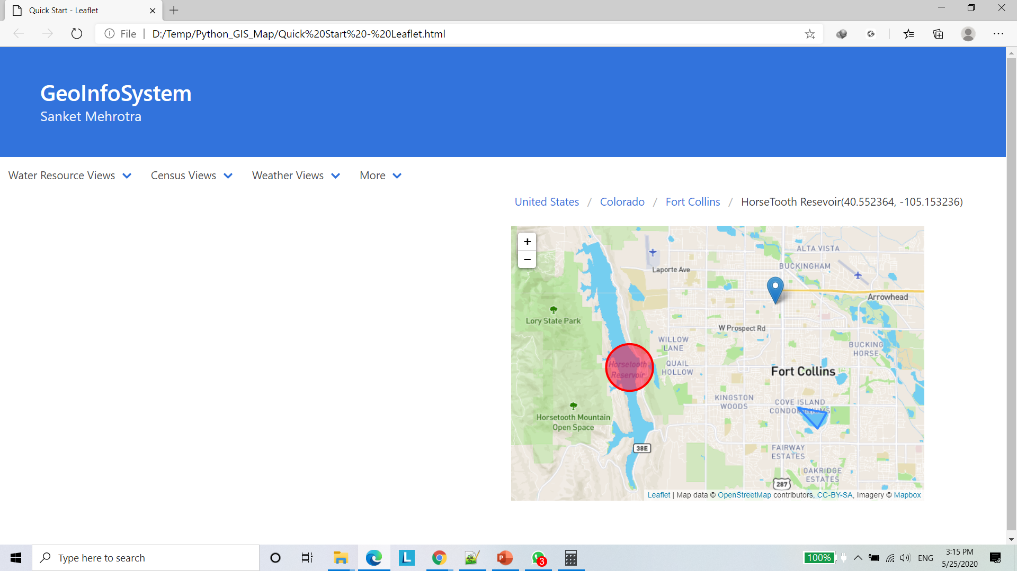
Water Volume:
Horsetooth Dam
Temperature: Larimer County
Projection model
View:
Projection of water level over 4 years

Slide 10
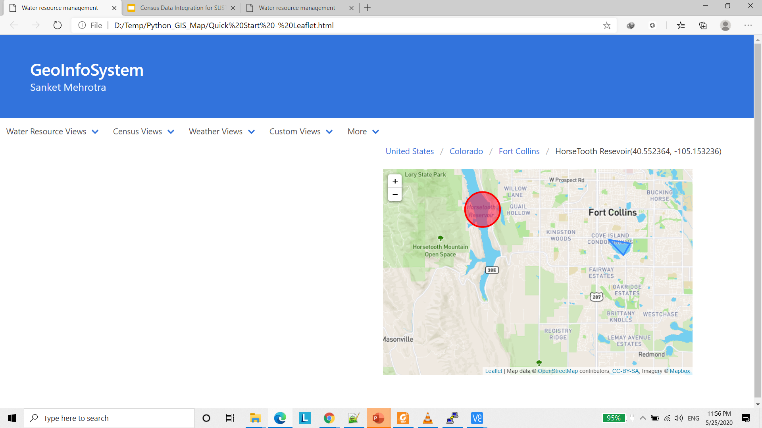
Configurable Input Options – Custom Views
Radio Button Menu
Follows System guided search
Forms intermediate layers by prompting user one choice at a time.

Slide 11
Outputs
Bokeh style – data encoded into image – works for 8 GB body texts. May be able to handle same amount of sketch/data source data

Slide 12
New Slides
(1) Developing the spatiotemporal query interface
- specify the geospatial coverage
- temporal coverage
- auto-detected features
- including the feature range
- stat graphs
- analytics graph (e.g. correlation matrix, building a linear model, plotting clusters (e.g. k-means, dbscan)

Slide 13
general ideas ->
main objectives ->
wireframes ->
coding the pages with their core functionality ->
implementing the final, polished design

Slide 14
(2) Provenance enabled retractable user query
- tracking the user’s query in the client device

Slide 15
(3) radar-view: brushing and linking across different resolutions (e.g. current resolution vs. much lower resolution)
- consider the data aggregation

Slide 16
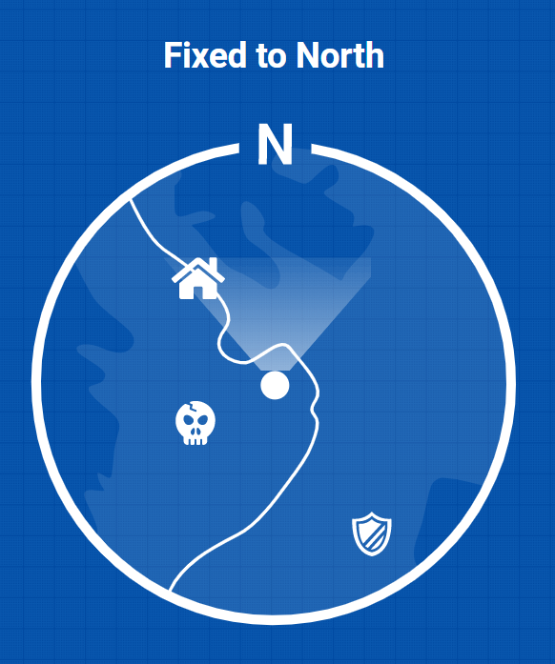
Radar View
To mark the different points of interest.(drops or jumps in correlated values)
20KW

